Slide 1
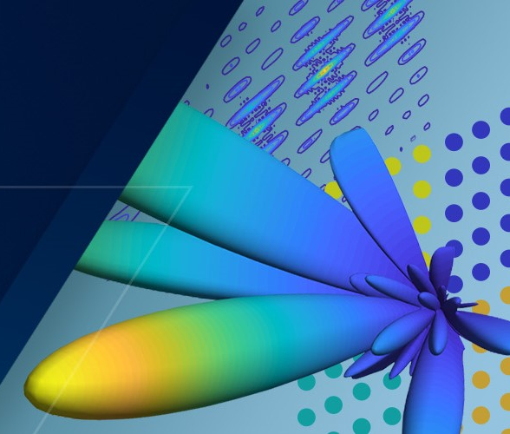
Hands-on Workshop :
Phased Array Design and Simulation in MATLAB
Akash Gopisetty , Product Marketing
Darius Subacius , Application Engineer
MathWorks
[ Date ]

Slide 2
Agenda
Setup and Logistics
Introduction
Hands-on exercises
Takeaways and Resources

Slide 3
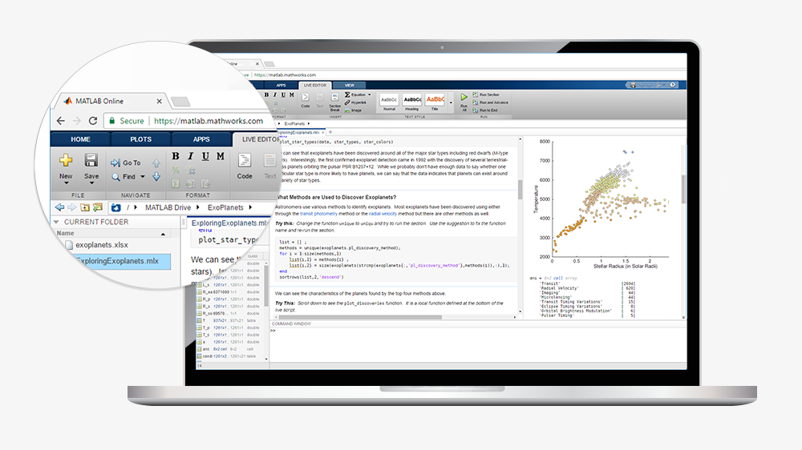
Use MATLAB Online for this workshop

Slide 4
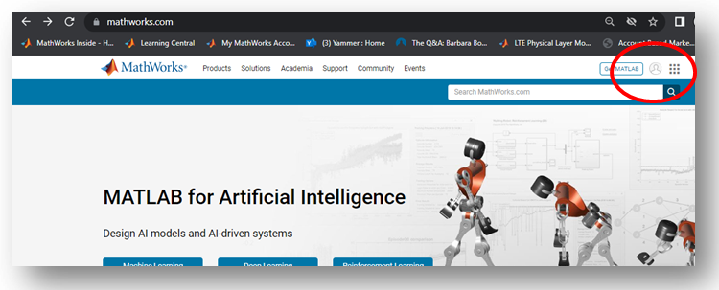
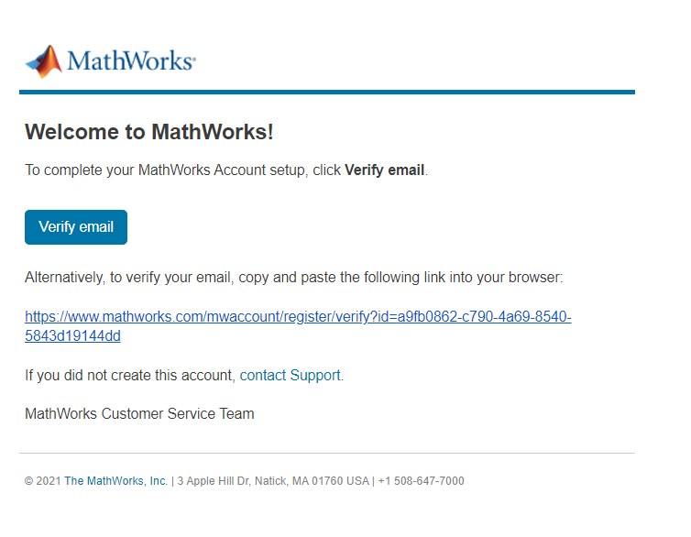
If you don’t already have MATLAB Online access:
Go to www.mathworks.com and click on the profile image at the top right
You will be prompted to create an account (please use your work address)
Once you get your confirmation email, please verify your account

Slide 5
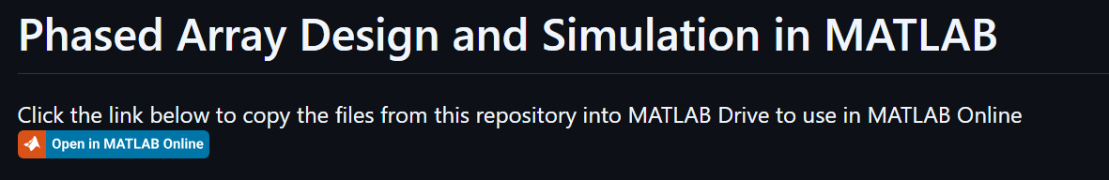
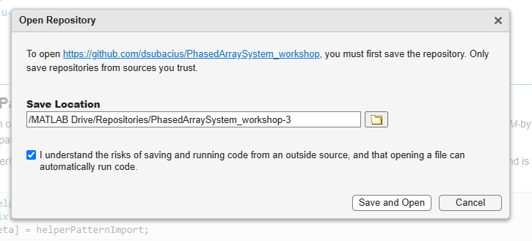
You will need two links for the workshop
1. Access MATLAB Online for 30 days:
URL in your workshop correspondence
2. Workshop code files on GitHub:
https://github.com/dsubacius/PhasedArraySystem_workshop/tree/main

Slide 6

Let’s hear from you!
We’ll run a few quick polls during the workshop to learn about your work and interests regarding phased arrays
Your responses help us tailor the discussion
No right or wrong answers—just insights
Join in when prompted!
Notes:
questions –
set up (voiceover) MATLAB? liveScript?
Are you working on phased arrays?
Elements
Are you doing Beamforming? What beamforming algorithms

Slide 7
Typical applications of phased arrays
Multifunction Radars
Wireless Communications
Satellite Communications
Audio / Underwater Acoustics
Notes:
Phased Arrays are used in a variety of different applications, here are just a few of them –
Multifunction Radars that put different beams in different directions and perform different tasks
For Wireless Communication – massive MIMO systems used in 5G systems and next gen 6G
Satellite Comms – where instead of having mechanical systems to steer the beam, they can electronically steer the beam with phased arrays
And Acoustic applications

Slide 8
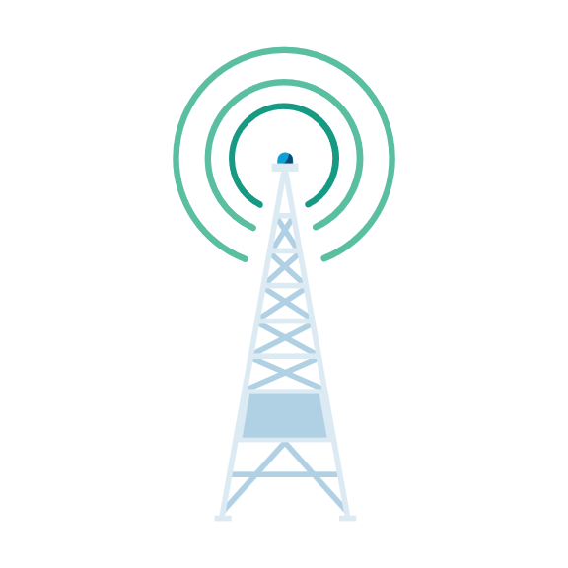
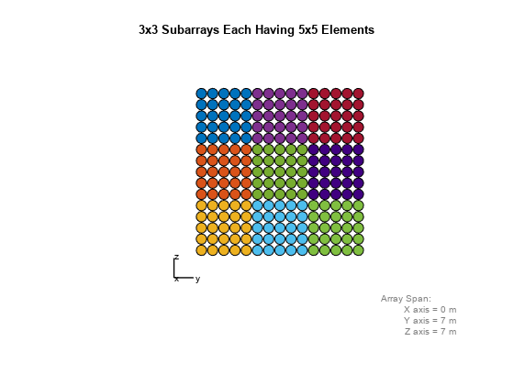
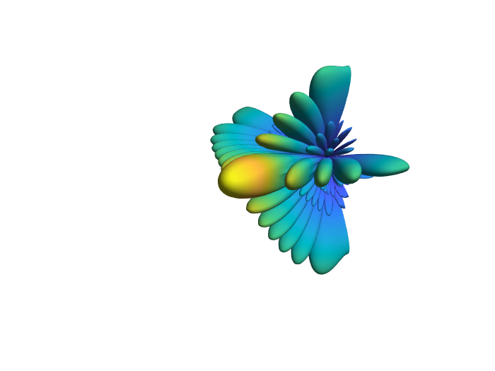
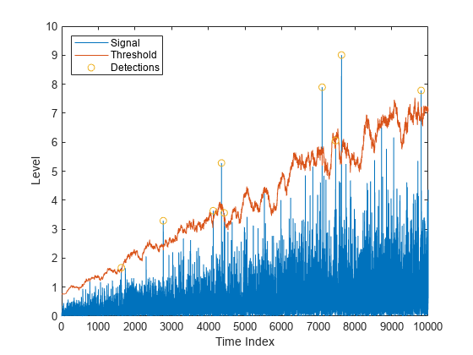

Design, Simulate and Analyze Phased Arrays
Array Design
Calibration
Interference Mitigation
Mutual Coupling
Signal Processing
Waveform Design
Notes:
Like any other systems, designing phased array systems presents several challenges. We will cover some of these challenges today like array design, signal processing and interference mitigation. But just know that the Phased Array Toolbox in MATLAB covers all these workflows.
How can arrays be designed to generate necessary beams while minimizing system complexity?
How should mutual coupling between elements be integrated into the model?
Once a signal is received, how is information extracted from it, such as direction of arrival or embedded data?
What if you have interference from external sources? be mitigated and the quality of received signals improved, leveraging array geometry?
In large arrays, where elements may fail or parameters differ from expectations due to manufacturing tolerances, how can calibration ensure effective operation despite such impairments?
Lastly, what waveforms do you send through these systems? Some of these have dual use - how can waveforms be designed to simultaneously detect targets and transmit signals to communicate with other users?

Slide 9
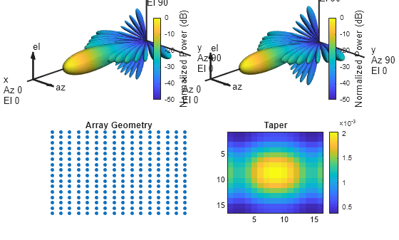
By the end of the workshop, you will be able to
Get started with phased arrays in MATLAB and apply them in your projects
Design and analyze various array configurations
Understand the basics of pattern synthesis
Integrate phased arrays into larger system-level models

Slide 10
Overview of exercises
Bonus Ex.
Array antenna in a scenario over
terrain
Beamforming, Nulling and Steering
Ex. 3
Rapid Prototyping of Antenna Arrays
(Sensor Analyzer App)
Ex. 2
Integrate antenna elements into phased array
Ex. 1

Slide 11
Overview of exercises
Implement array in a scenario over terrain
Ex.4
Beamforming, Nulling and Steering
Ex. 3
Rapid Prototyping of Antenna Arrays
(Sensor Analyzer App)
Ex. 2
Create an array with custom antenna elements
Ex. 1

Slide 12
Exercise 1: Integrate antenna elements into phased array
Goals:
Familiarize with Phased Array System toolbox objects using command line interface
Learn how to import a custom antenna element design from HFSS
Construct and analyze a Uniform Rectangular Array (URA) using the defined antenna elements.
Familiarize yourself with the MATLAB Online environment.

Slide 13
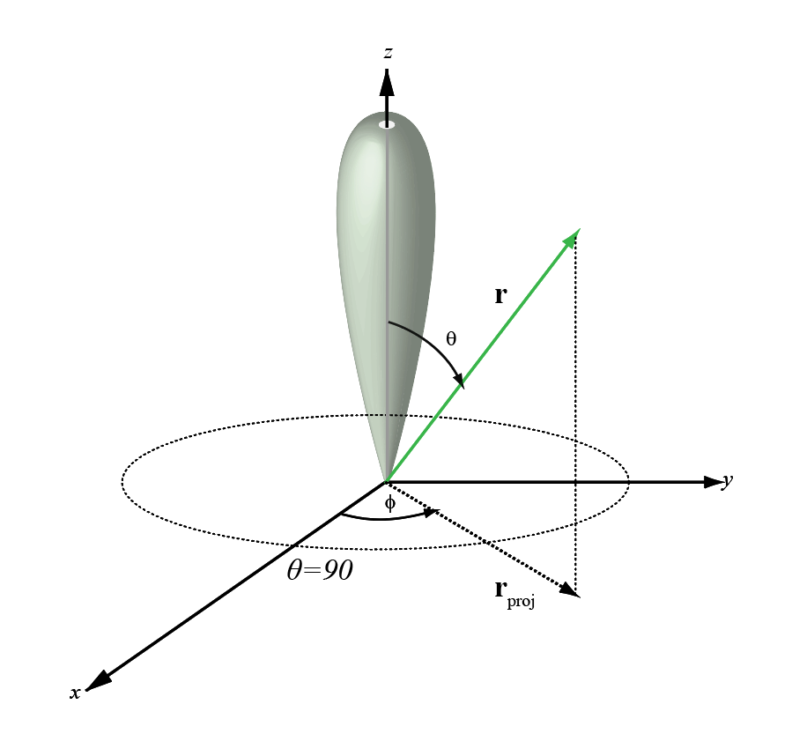
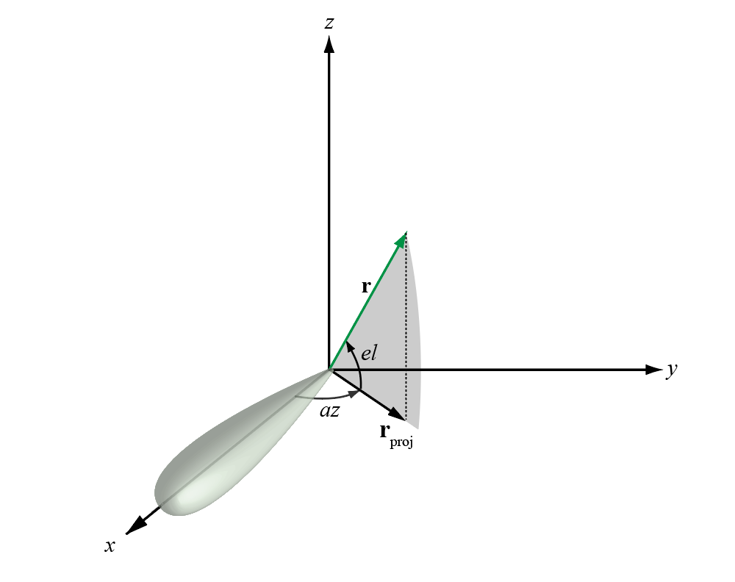
Spherical Coordinate System in the Phased Array Toolbox
Define a point in space with distance and two angles
Phased Array Toolbox natively uses azimuth / elevation
The toolbox provides functions to convert between different spherical coordinate systems
u=sinθcosϕ
v=sinθsinϕ
Az [-180:180]
El [-90:90]
Phi [0:360]
Theta [0:180]
mathworks.com/help/phased/ug/spherical-coordinates.html
Notes:
For high fidelity pattern analysis, you often need to use a custom radiation pattern obtained from measurements or simulations.
There is no standard convention for the coordinate system used to specify the radiation pattern, so the result from one simulation package often cannot not be directly used in another software package. For example, in Phased Array System Toolbox™ (PST), the radiation pattern is expressed using azimuth (az) and elevation (el) angles, as depicted in Figure 1. It is assumed that the main beam of the antenna points toward azimuth and elevation, that is, the x-axis. The value of az lies between and and the value of el lies between and . See Spherical Coordinates.
Define a point in space with distance and two angles: In 3D space, the location of a point relative to an origin can be described using a radial distance and two angles.
Phased Array Toolbox primarily uses Azimuth / Elevation:
Azimuth (Az): This is the angle in the XY-plane, measured from the positive X-axis towards the positive Y-axis. It typically ranges from -180° to 180° (or 0° to 360°).
Elevation (El): This is the angle measured from the XY-plane up towards the positive Z-axis (or down towards the negative Z-axis). It typically ranges from -90° to 90°.
Alternative Spherical Coordinates (Phi / Theta) and Conversions:
Phi (ϕ): Often represents the azimuthal angle, similar to Az, typically measured from the positive X-axis towards the positive Y-axis. Ranges from 0° to 360°.
Theta (θ): Often represents the polar angle, measured from the positive Z-axis downwards. It typically ranges from 0° to 180°.
The toolbox provides functions to convert between different spherical coordinate systems (e.g., azel2pat, pat2azel) to ensure flexibility when integrating with data from various sources or standards.
Mx3 matrix
1st : Az angles Phi
2nd : El angle Theta
3d: Radiation pattern, dB

Slide 14
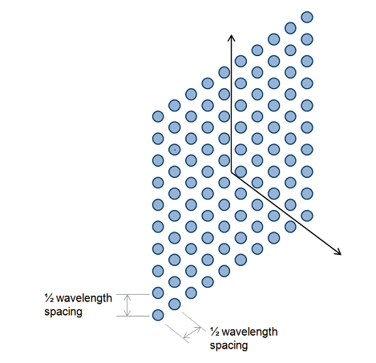
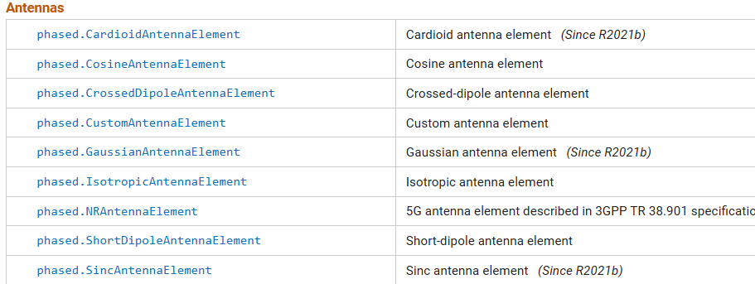
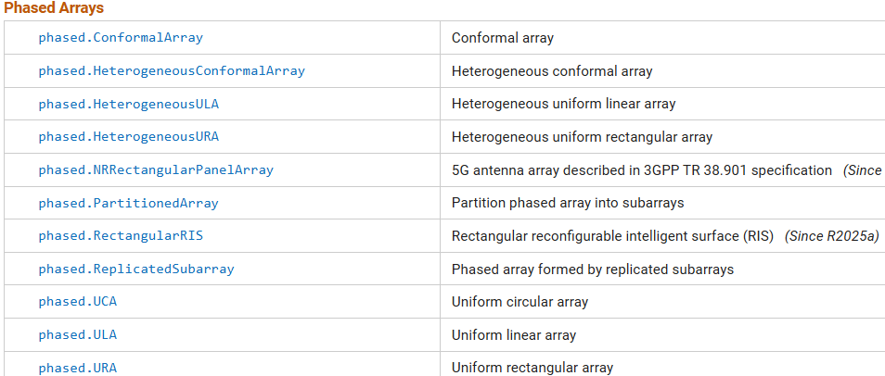
Phased Array System Toolbox uses functions and objects:
Open the link below and view list
Once defined, system objects can be used as functions
mathworks.com/help/phased/referencelist.html
Notes:
In MATLAB, both System objects and functions are fundamental constructs for organizing and executing code. While functions are a general-purpose programming tool, System objects are specialized classes designed for efficient implementation and simulation of dynamic systems, particularly those that involve streaming data or internal states.
A System object is a specialized MATLAB class designed for implementing and simulating dynamic systems with inputs that change over time.
Object-oriented structure: They are built as MATLAB classes, inheriting from matlab.System. This provides a structured way to define properties (data) and methods (operations).
But for our purpose System Objects can be used as functions with input arguments

Slide 15
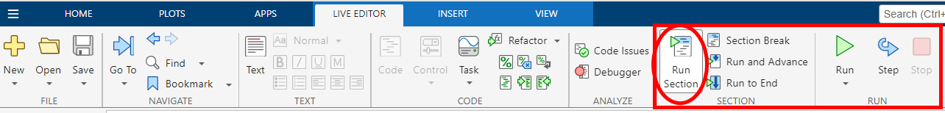
MATLAB Live Scripts and Coding Practices
Value-only arguments don’t need any modifiers
Name-value pairs use property names
y = foo(arg1, ... % Value-only argument
Name1=value1); % Name-value pair
Name=value, and “Name”,value, and ‘Name’,value are all equivalent when specifying name-value pairs
Use only one style in a given function call
Read the code comments! They contain helpful instructions to guide your code, including the usage of value-only arguments and name-value pairs.

Slide 16
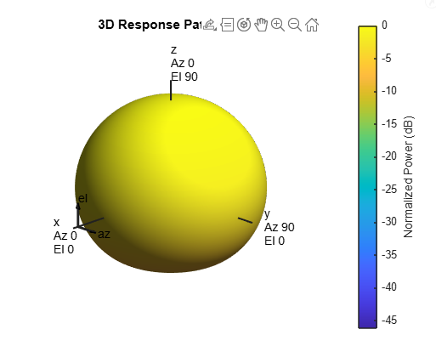
Exercise 1: Create an array with custom antenna elements
Steps:
Create antenna element object
Create a Cosine Antenna element object
Import antenna element
Plot element radiation pattern
Construct 8x8 URA using these elements
Visualize and analyze URA radiation pattern
Related Resources
mathworks.com/help/phased/ug/antenna-array-analysis-with-custom-radiation-pattern.html
WORK ON EXERCISE 1
(15 minutes)

Slide 17
Do you design antennas specifically for phased array systems? Are you focused more on element-level design, array configuration, or both?
2. What tools or software do you typically use for antenna or array design? e.g., MATLAB, CST Studio, HFSS, in-house tools?
3. How important is electromagnetic (EM) analysis in your workflow? Do you perform full-wave simulations, or rely more on array-level approximations?
Let’s hear from you!

Slide 18
Overview of exercises
Bonus
Ex.
???
Beamforming, Nulling and Steering
Ex. 3
Rapid Prototyping of Antenna Arrays
(Sensor Analyzer App)
Ex. 2
Create an array with custom antenna elements
Ex. 1

Slide 19
Exercise 2: Rapid Prototyping of Antenna Arrays
Goals:
Quick experiment with different array configurations
View resultant beam pattern and 3D patterns
Use the Sensor Array Analyzer App

Slide 20
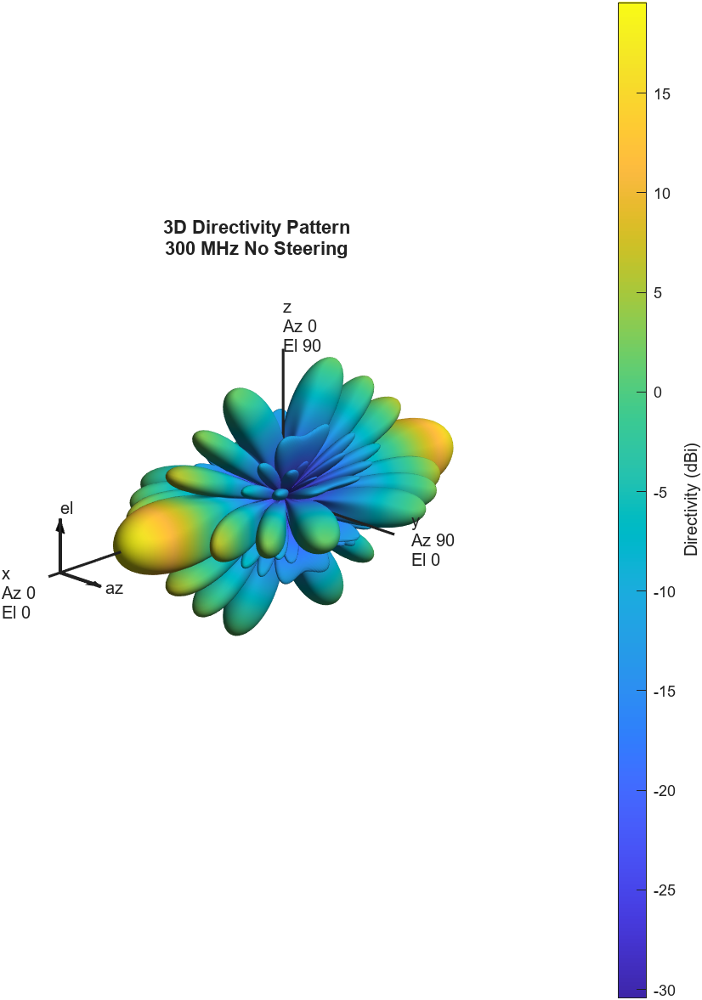
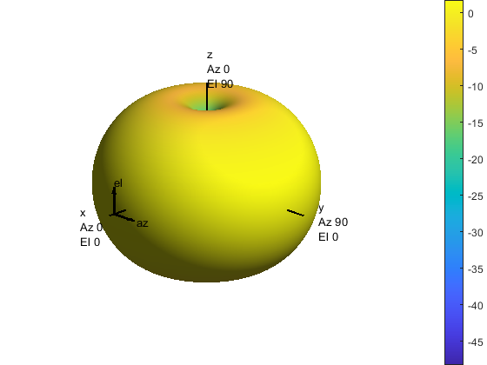
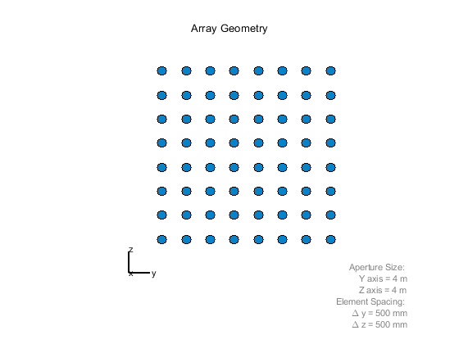
Array Patterns are Determined by Element Pattern and Spatial Configuration
Element Pattern
Array Pattern
Array Factor

Slide 21
Options for Array Factor
Uniform Linear Array
Uniform Rectangular Array
Circular Planar Array
Custom Array Geometry
Array Factor
Element Pattern
Array Pattern
Notes:
I mentioned there are several pre-defined geometries there are within our tool. There's a few basic geometries you can get started with, a like a linear array or the planar array. You can also define a custom geometry or a conformal array based on your needs in 2D or 3D.

Slide 22
Options for element patterns
Short Dipole
Crossed Dipole
Isotropic Antenna
Cosine Antenna
Gaussian Antenna
Cardioid Antenna
Sinc Antenna
Array Factor
Element Pattern
Array Pattern
Notes:
Let's talk about element patterns. There are several mathematical models of antenna that are available right out of the toolbox to get started. Some of these even support polarization (models). These are all patterns that you can implement into the arrays you design.

Slide 23
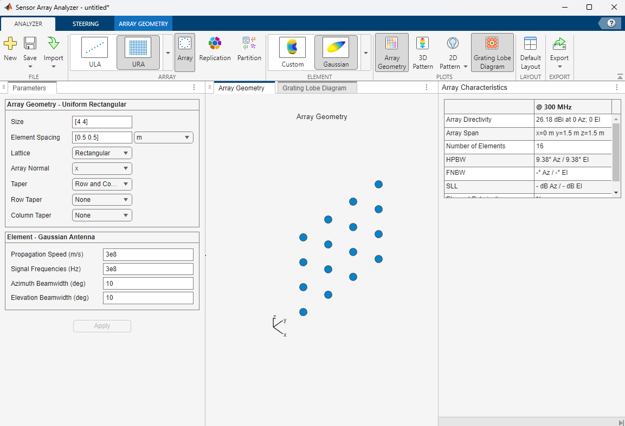
Exercise 2: Rapid Prototyping of Antenna Arrays
Open the Sensor Array Analyzer App
Apps tab from MATLAB
Command Line:
>> sensorArrayAnalyzer

Slide 24
Exercise 2: Rapid Prototyping of Antenna Arrays
Steps:
Experiment with different array factors and element patterns.
View 3D and 2D patterns
Design and export phased array with the following configuration:
Antenna Elements:
Isotropic
Back Baffled
URA 8 x 8
Spacing ½ λ
Signal Freq 2.5 GHz
Azimuth Steering Angle 15
Export to MATLAB
Extra Credit:
Find the effect of grating lobes and tapering
Partition array into subarrays
WORK ON EXERCISE 2
(15 minutes)

Slide 25
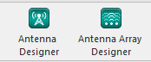
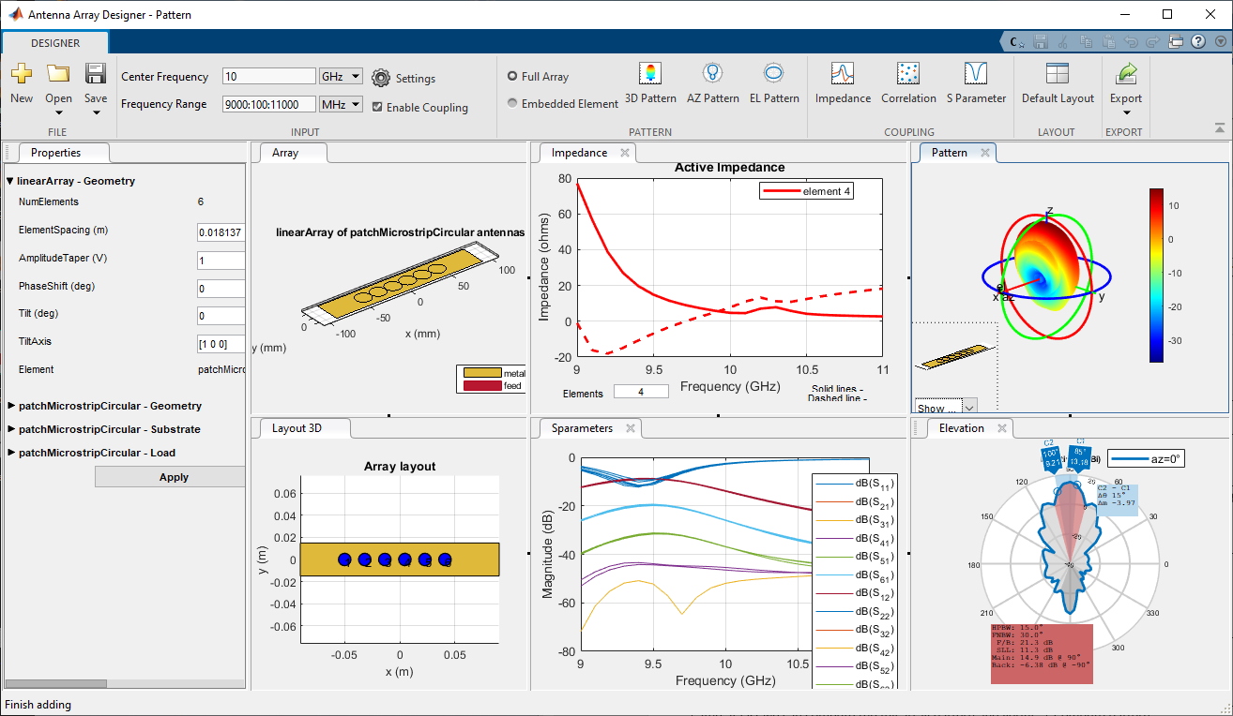
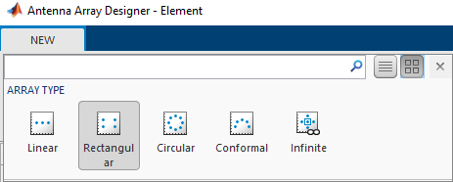
Related Resources
Antenna Toolbox:
Full-wave and hybrid electromagnetic solvers for antenna elements and arrays
Do port, surface, and field analysis, antenna placement studies, and radar cross section (RCS) calculations.
Export designed antennas for fabrication using CAD and Gerber files
Notes:
So with the antenna array Designer app we execute EM simulations<click> and we can take into account coupling effects in our design. What are the steps?<click>
Select an array geometry. And emphasizing that arbitrary 3D design can be performed by the conformal option.<click>
Choose and design the individual element at the operating frequency. It is worth of mentioning that radiation patterns can be directly imported, even obtained from other 3rd party simulators <click>
Visualize results and iterate on the array geometrical properties<click>
Finally MATLAB scripts can be generated for automation or antenna array blocks be created to be included in the Simulink RF simulation environment.
$$F_{total}=F_{1}+\frac{F_{2}−1}{G_{1}}+ \frac{F_{3}−1}{G_{1}G_{2}}+\frac{F_{4}−1}{G_{1}G_{2}G_{3}}+ …+\frac{F_{n}−1}{G_{1}G_{2}{…G}_{n−1}}$$
$$\frac{1}{{OIPN}_{total}}=\frac{1}{{OIPN}_{1}}+ \frac{G_{2}}{{OIPN}_{2}}+\frac{G_{2}G_{3}}{{OIPN}_{3}}$$

Slide 26
Overview of exercises
Bonus Ex.
???
Beamforming, Nulling and Steering
Ex. 3
Rapid Prototyping of Antenna Arrays
(Sensor Analyzer App)
Ex. 2
Create an array with custom antenna elements
Ex. 1

Slide 27
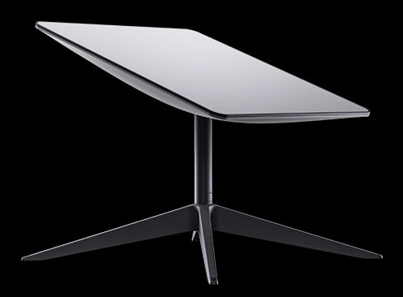
Phased Array Antenna Performance Specifications
Starlink User Terminal Phased Array Antenna
Parameter
Operating Frequency Bands and Bandwidth | e.g. Ku-band (12-18 GHz) Ka-band (27-40GHz)
Antenna Architecture and Element Design | Antenna element, polarization, number of elements
Beamforming and Steering Performance | FOV, Beamwidth, Side Lobe Levels
Gain | Gain and directivity
Specification | Starlink High Performance
Dimensions (L x W x H) | 22" × 20" × 1.6" (575 x 511 x 41 mm) ¹⁸
Weight | 16 lbs (7.2 kg)
Average Power Consumption (Active) | 110-150W
Idle Power Consumption | 45W
Field of View | 140°
Orientation | Fixed
Primary Frequency Band | Ku-band (12-18 GHz)
Estimated Element Count | ~1000-1200
https://www.starlink.com/us/specifications?spec=2
Notes:
Key Technical Specifications and Design Parameters
The performance and utility of phased array antennas are defined by a comprehensive set of technical specifications and design parameters. These parameters dictate the antenna's capabilities, its suitability for various applications, and its operational behavior in diverse environments.
phased array beam steering in Starlink's architecture cannot be overstated. Data is continuously exchanged between the ground user terminal (known as "Dishy McFlatface") and Starlink satellites, which traverse the sky at an incredible speed misalignment of approximately 27,000 kilometers per hour. Phased array allows fast beam steering
The antenna's nominal gain is 40 dBi at 12.5 GHz, but there are losses of at least 4-5 dB due to lack of a circular-to-linear polarizer and to feedhorn.

Slide 28
Exercise 3: Beamforming, Nulling and Steering
Goals:
Calculate weights for a ULA
Meet given requirements for array performance
Get familiar with minimum variance optimization
Perform beamforming, nulling and steering

Slide 29
What is Beamforming and Nulling?
Adjust weights of array elements to enhance signals from:
desired directions (steering)
suppress interference/noise from others (nulling)
Conventional (fixed weights) vs Adaptive (respond to environment)
Narrowband (constant phase shifts) vs Wideband (time delays)
Sensor
Array
Steering
Delay
Signal
Alignment
Signal
Wavefront
t=τ₂
Enhanced
Signal
t=τ₁
Σ
t=0
www.mathworks.com/help/phased/beamforming.html
Notes:
The principle of beamforming can be outlined in this animation. The signal comes in as a plane wave. It hits the sensor in the array one by one. In the receiver, the signal received at each element are delayed accordingly so that in the end they are aligned together and then combined to generate a stronger signal
Conventional beamformers have fixed weights while adaptive beamformers have weights that respond to the environment. Use adaptive beamformers to reject spurious or interfering signals from non-target directions.
In narrowband beamforming the signal bandwidth is smaller than the carrier, a constant phase shift are applied at each element to align the signals. For wideband beamforming, where the signal occupies a larger range of frequencies. Beamforming is done using time delays to avoid distortion. This implementation tends to be more complex (ultra-wideband radars, 5G and sonar systems)

Slide 30
Supported beamformers in MATLAB
Beamformer Name | Bandwidth | Processing Domain
phased.PhaseShiftBeamformer | Narrowband | Time domain
phased.TimeDelayBeamformer | Wideband | Time domain
phased.SubbandPhaseShiftBeamformer | Wideband | Frequency domain
phased.LCMVBeamformer | Narrowband | Frequency domain
phased.MVDRBeamformer | Narrowband | Frequency domain
phased.FrostBeamformer | Wideband | Time domain
phased.GSCBeamformer | Wideband | Time domain
phased.TimeDelayLCMVBeamformer | Wideband | Time domain
phased.SubbandMVDRBeamformer | Wideband | Frequency domain
Conventional
Adaptive
mathworks.com/help/phased/ug/beamforming-concepts.html
Notes:
Conventional beamformers are best when simplicity, robustness, and low computational load are priorities, but they offer limited resolution and interference rejection. Use conventional beamforming for simpler, more robust applications with less dynamic interference.
Adaptive beamformers provide superior interference suppression and resolution but require more computation and are sensitive to modeling errors. Use adaptive beamforming when higher performance is needed in challenging, interference-rich, or dynamic environments—provided you can manage the extra complexity and computational cost.

Slide 31
Minimum Variance Beamforming: Adaptive Array Weight Design
Computes array weights that minimize output noise/interference while preserving gain in desired direction
Mathematically it is an optimization problem
Narrower main lobe, deeper nulls compared to conventional beamforming
Adaptive: responds to interference environment
When sidelobes are suppressed, the main lobe widens
In MATLAB:

Slide 32
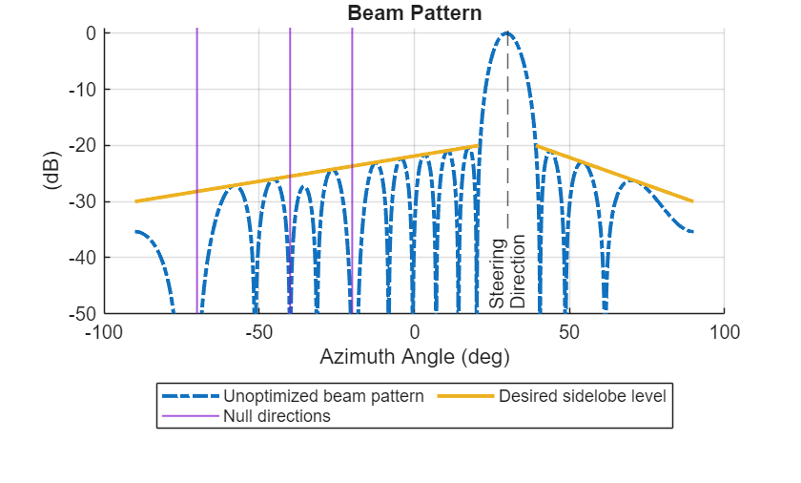
Exercise 3: Beamforming, Nulling and Steering
Steps:
Use minimum-variance algorithm to calculate array weights to meet these requirements:
Plot and view the resultant beam pattern
Specifications | Details
Configuration and Size | Uniform Linear Array with 16 elements
Operating frequency | 3 GHz
Main beam angle / Broad side (Az) | 30°
Null angles | -70°, -40°, -20°
Side Lobe Level (SLL) Suppression | Linear from -20dB to -30dB (symmetric)
WORK ON EXERCISE 3
(15 minutes)

Slide 33
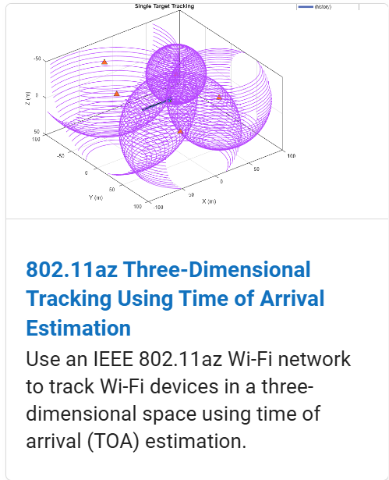
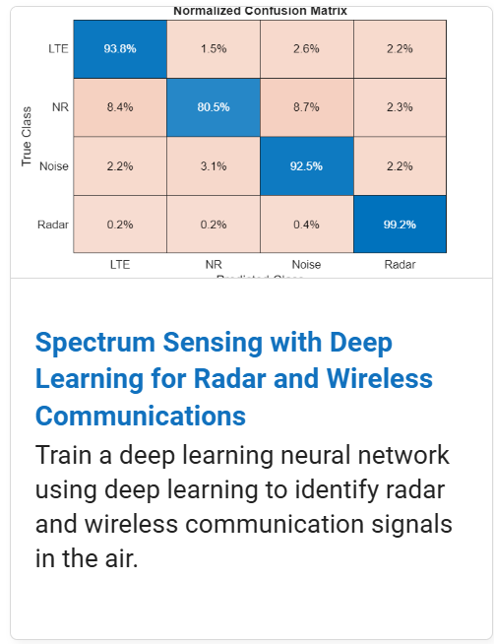
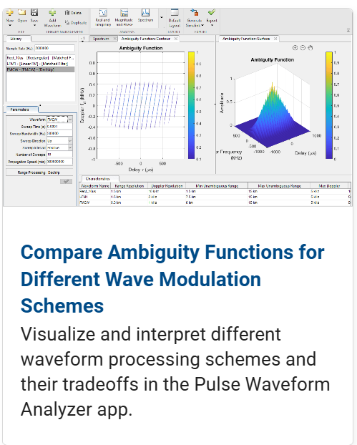
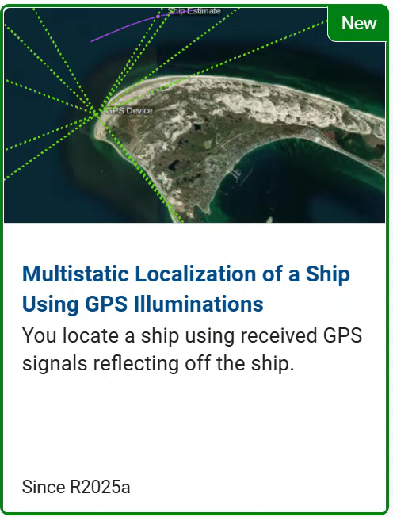
Other Key Topics (Not Covered Today)
Direction of Arrival Estimation and STAP
Detection, Range and Doppler Estimation
Waveform Design and Signal Synthesis
Radar and Wireless Coexistence
Localization

Slide 34
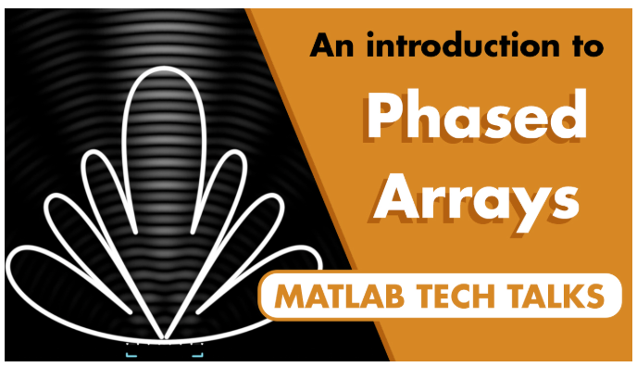
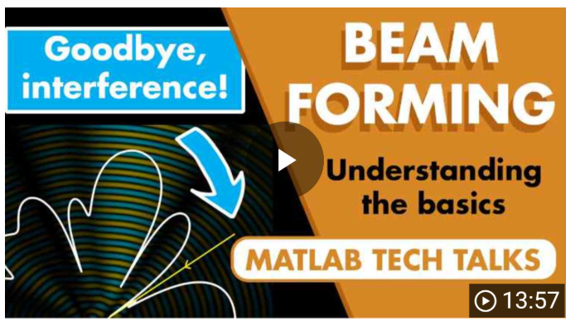
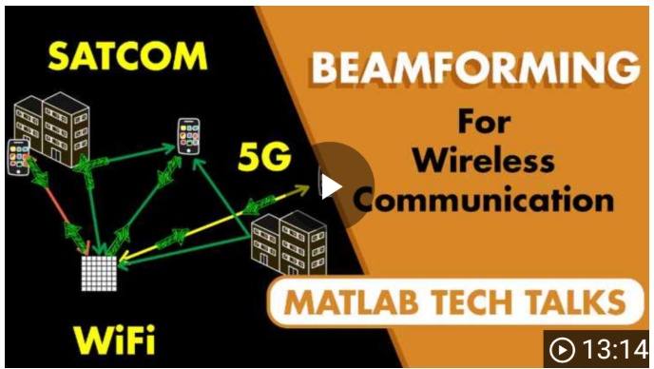
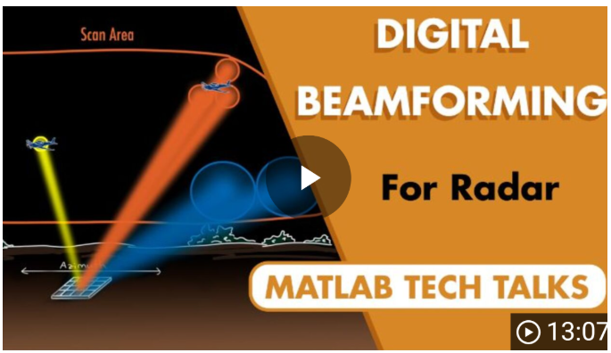
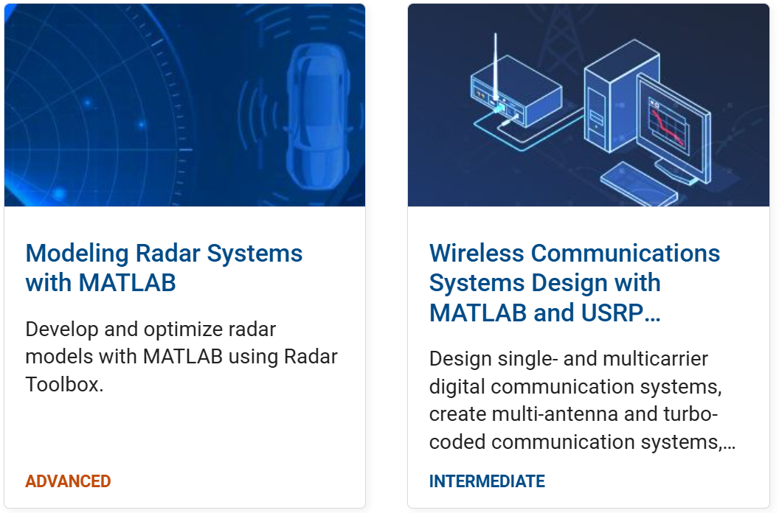
Related Resources:
Get Started with the Phased Array System Toolbox
MATLAB Tech Talks Series on Phased Arrays and Beamforming
2-Day Course: Modeling Radar Systems with MATLAB

Slide 35
Summary
Skills You Gained Today:
Built foundational skills in modeling and simulating phased array systems using MATLAB
Designed and visualized custom array configurations
Leveraged interactive tools like the Sensor Array Analyzer for rapid design evaluation
Applied optimization techniques to steer beams and enhance array performance
Explored a streamlined workflow from antenna import to performance tuning
Next Steps in Your Learning Journey:
Explore documentation and example workflows to deepen your understanding
Take the next step with online training modules and self-paced courses on array systems, radar, and wireless
Practice and prototype on your own. Explore bonus exercise!

Slide 36
Thank You!

Slide 37
Overview of exercises
Implement array in a scenario over terrain
Ex.4
Beamforming, Nulling and Steering
Ex. 3
Rapid Prototyping of Antenna Arrays
(Sensor Analyzer App)
Ex. 2
Create an array with custom antenna elements
Ex. 1

Slide 38
Exercise 4: Implement array in a scenario over terrain
Goals:
Deploy antenna array in real world scenario over a terrain
Create RF Scenario using Antenna Toolbox Siteviewer (transmit and receive sites)
Verify Line-of-Sight Link Visibility and measure received signal and interference power levels
Implement Interference Nulling Workflow using MVDR Beamformer

Slide 39
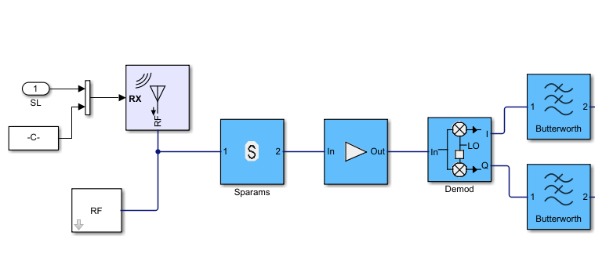
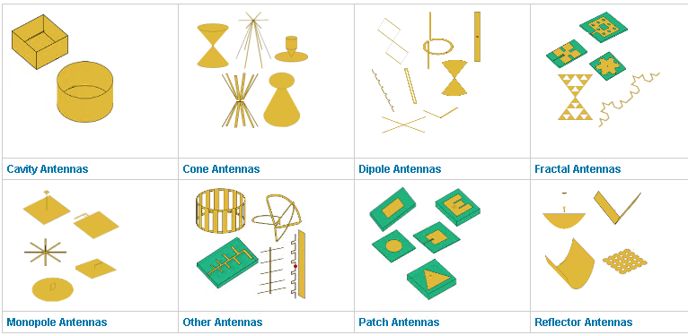
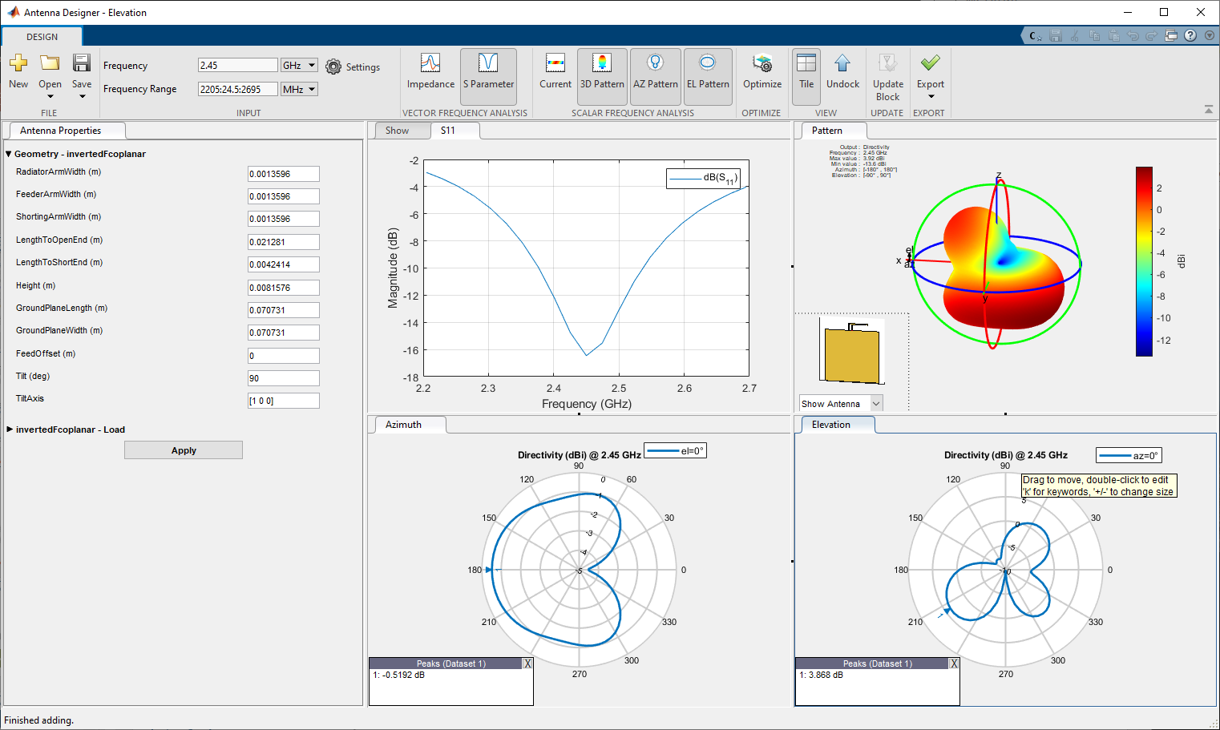
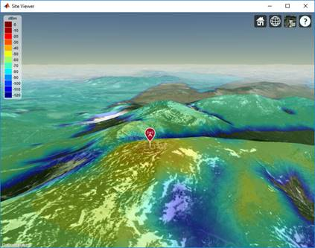
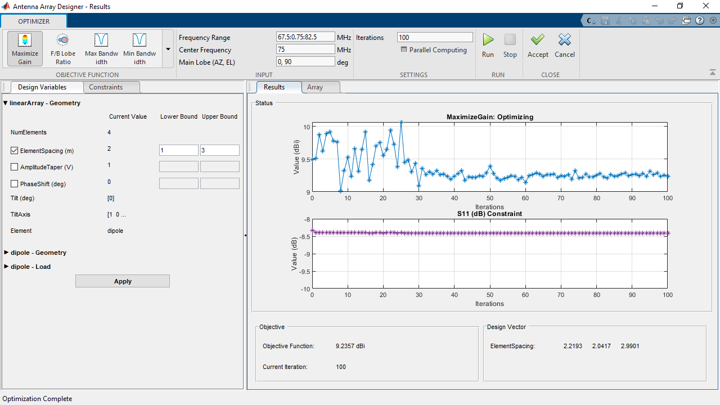
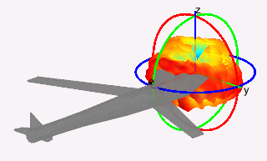
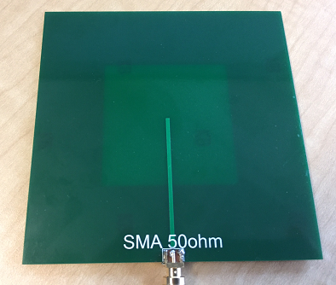
What can I do with Antenna Toolbox?
Integration
Design
Analysis
Antenna Toolbox
Propagation
Optimization
Installation
Fabrication

Slide 40
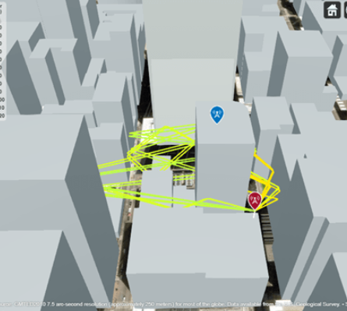
RF Propagation Models in Antenna Toolbox
Atmospheric Models:
Free Space: Ideal line-of-sight (LOS) propagation.
Rain, Gas, Fog: Account for atmospheric attenuation due to weather conditions.
Empirical Models:
Close-In: Statistical path loss for urban macro-cell scenarios, including non-line-of-sight (NLOS).
Terrain Models:
Longley-Rice (ITM) & TIREM: Point-to-point path loss over irregular terrain, considering diffraction and ground reflection.
Ray Tracing Models (Advanced):
Shooting and Bouncing Rays (SBR): Simulates reflections and diffractions (approximate path count, exact geometry).
Image Method: Exact propagation paths with precise geometric accuracy for reflections.
Key Features: Multipath analysis, material property considerations, polarization, path loss, phase shift, and GPU acceleration.
Notes:
MATLAB's Antenna Toolbox provides a comprehensive suite of RF propagation models to simulate how electromagnetic waves travel through various environments.
The Longley-Rice model, is a widely used empirical and statistical model for predicting radio signal propagation over irregular terrain. (f=20MHz-20GHz), distance=1km-2000km
It combines elements of physics-based propagation (like free-space loss, diffraction, ground reflection, atmospheric refraction, and tropospheric scatter) with empirical data.
The model uses terrain elevation data between the transmitter and receiver to determine path characteristics, such as terrain roughness, path inclination, and the presence of obstacles.
External Library Requirement: A crucial distinction is that TIREM in MATLAB's Antenna Toolbox requires access to an external TIREM library (often a separate installation or license from the TIREM software itself). It's not entirely self-contained within MATLAB's core installation. Frequency Range: Valid from 1 MHz to 1000 GHz, though when used with Antenna Toolbox elements and arrays, the frequency range is typically limited to 200 GHz. Antenna Height: Supports antenna heights up to 30,000 m.

Slide 41
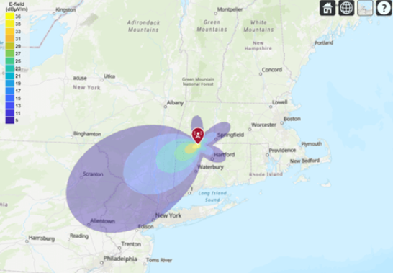
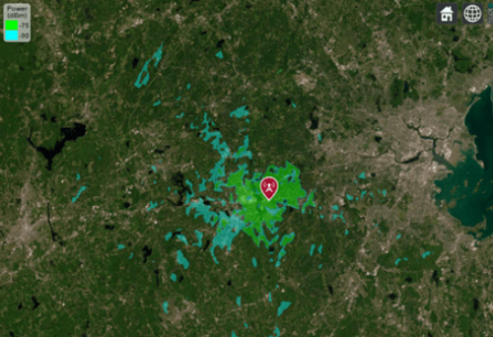
Visualization and Analysis with Antenna Toolbox
Interactive 3D Site Viewer:
Transmitter & Receiver Placement: Easily define and place sites on a 3D globe or custom scene
Coverage Maps: Visualize received signal strength (e.g., dBm), SINR, or link status
Propagation Path Visualization: Plot individual ray paths showing reflections and diffractions
Terrain & Basemap Integration: Incorporate real-world terrain and basemaps for realistic context
Analysis & Metrics:
Path Loss: Calculate signal attenuation
Signal Strength & SINR: Determine received signal quality
Link Status: Evaluate communication link success
LOS/NLOS Analysis: Determine visibility between sites
Integration & Customization:
Define transmitter/receiver properties (txsite, rxsite).
Configure propagation models (propagationModel).
Programmatic control for automation and scripting.
Customize building properties from OpenStreetMap files
Notes:
Beyond modeling, the Antenna Toolbox offers powerful visualization and analysis tools for RF propagation.

Slide 42
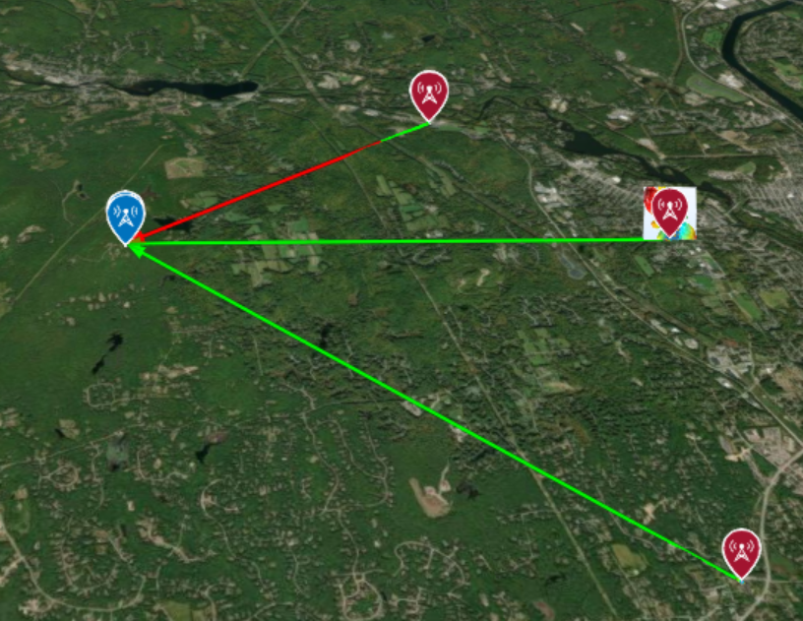
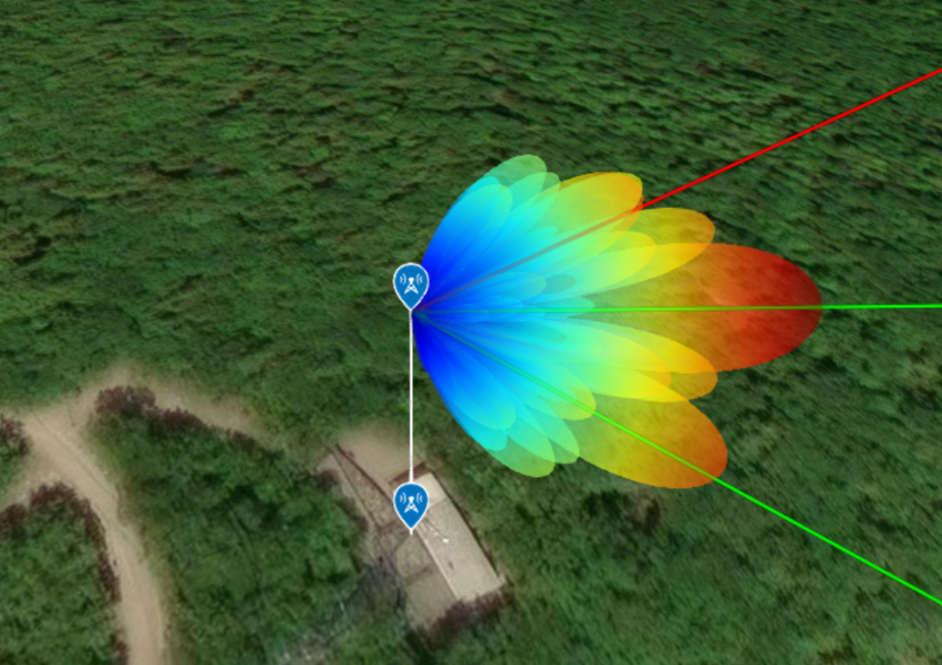
Exercise 4 steps: Deploy antenna array in real world scenario
Create RF Scenario including the terrain (transmit and receive sites)
Create RF receive site
Create Tx Sites: 1 RF communication link and 2 interfering sites in 2.5 GHz Band
Verify Line-of-Sight Link Visibility
Specify Receive and Transmit site antennas
Use / Import 8-by-8 Receive Station Antenna Array
Create 4-by-4 Tx Site Antenna Array
Calculate Received Signal Strength From Signal link and interference without Beamforming
Interference Nulling Workflow using MVDR Beamformer (next slide)

Slide 43
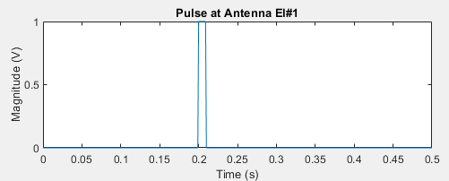
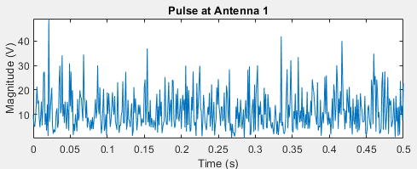


Exercise 4 steps : adaptive beamforming workflow
Define Antenna Array & Signal Scenario
Create Phased Array received signal
Generate Tx signal waveform
Add noise and interference signals
Simulate received plane waves at array (using collectPlaneWave)
Create MVDR Beamformer object
Specify URA object, input angle
Apply MVDR Beamformer for received signal
Define Steering Vector for Desired Signal
Plot Array Radiation pattern after beamforming
Visualize the array pattern to observe nulls in interference directions
compute received signal strength after beamforming
Notes:
Define Antenna Array & Signal Scenario:
Specify array geometry (e.g., phased.ULA, phased.UCA).
Define desired signal (Direction of Arrival - DOA, frequency).
Define interference signals (DOA, frequency).
Set noise characteristics.
Simulate Received Array Data:
Generate the received signal at each array element, incorporating desired signal, interference, and noise.
MATLAB Functions: collectPlaneWave, phased.ArrayResponse

Slide 44
Exercise 4: functions used in exercise
RF Scenario modeling using Antenna toolbox
Siteviewer
Display transmitter sites, receiver sites, and RF propagation visualizations by using a siteviewer object.
Default mode: 3-D globe — Display sites that are referenced to geographic coordinates. You can customize the globe using custom terrain, high-zoom-level or custom basemaps, and buildings.
txsite, rxsite
Display transmitter and receiver sites on a 3-D globe, calculate the distance and angles between the sites, and analyze the signal strength of the transmitter at the receiver site.
los
Display or compute line-of-sight (LOS) visibility status
sigstrength (rx,tx,"freespace")
https://www.mathworks.com/help/releases/R2024b/antenna/ref/siteviewer.html
Notes:
RF propagation models of signals as they travel through the environment. You can display transmitter sites, receiver sites, and RF propagation visualizations by using Site Viewer, an interactive 3-D viewer. Site Viewer enables you to visualize propagation models in both outdoor and indoor environments.

Slide 45
WORK ON EXERCISE 4 (20 minutes)

